Slide 1
Day 3 -API Integration Report –
[Rental E-commerce Website]
Morent

Slide 2
API INTEGRATION
To successfully integrate the API for the Rental Car System, follow these key steps:
Connect the frontend with the backend to enable dynamic data retrieval.
Use Sanity CMS as the backend to store and manage car rental data.
Retrieve car data via API and display it dynamically.
Implement sorting for better user experience
Ensure responsiveness and error handling.
Procedure
Step 1 Installing Sanity Studio
Create a new NEXT.JS Project with sanity or integrate a new sanity project into a new existing NEXT.JS project
Step 2 Setting Environment Variables
1. Created a .env.local file at the root of the project.
2. Added the following environment variables:
a. NEXT_PUBLIC_SANITY_PROJECT_ID: Your Sanity project ID.
b. NEXT_PUBLIC_SANITY_DATASET: Dataset name (e.g ., production).
c. SANITY_API_TOKEN: Token for API authentication.

Slide 3
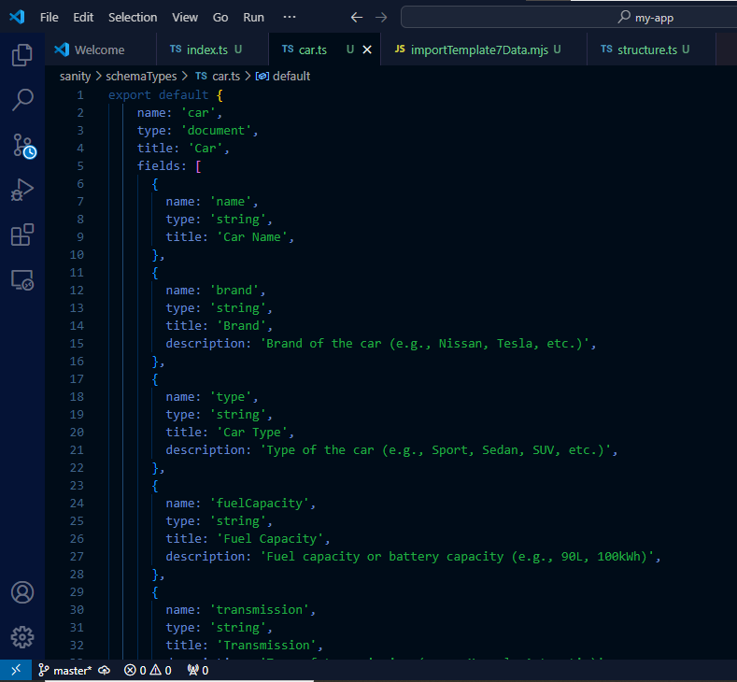
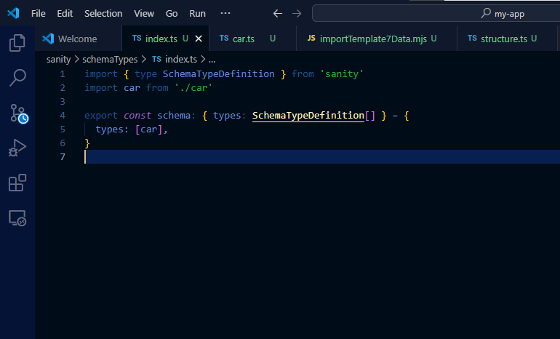
Step 3 Configuration For Data Fetching
Configure Sanity, by defining schema, types and other settings.
Define Car Data Types for the project
Create a migration script to connect with Sanity CMS
Update package.json
Execute the script with npm commands

Slide 4
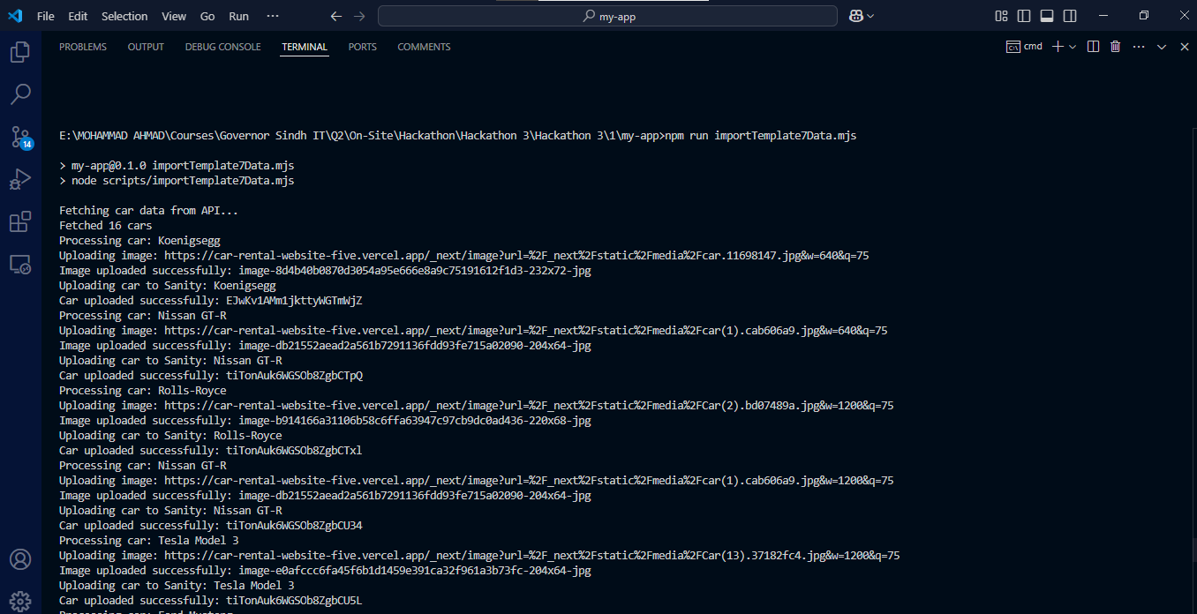
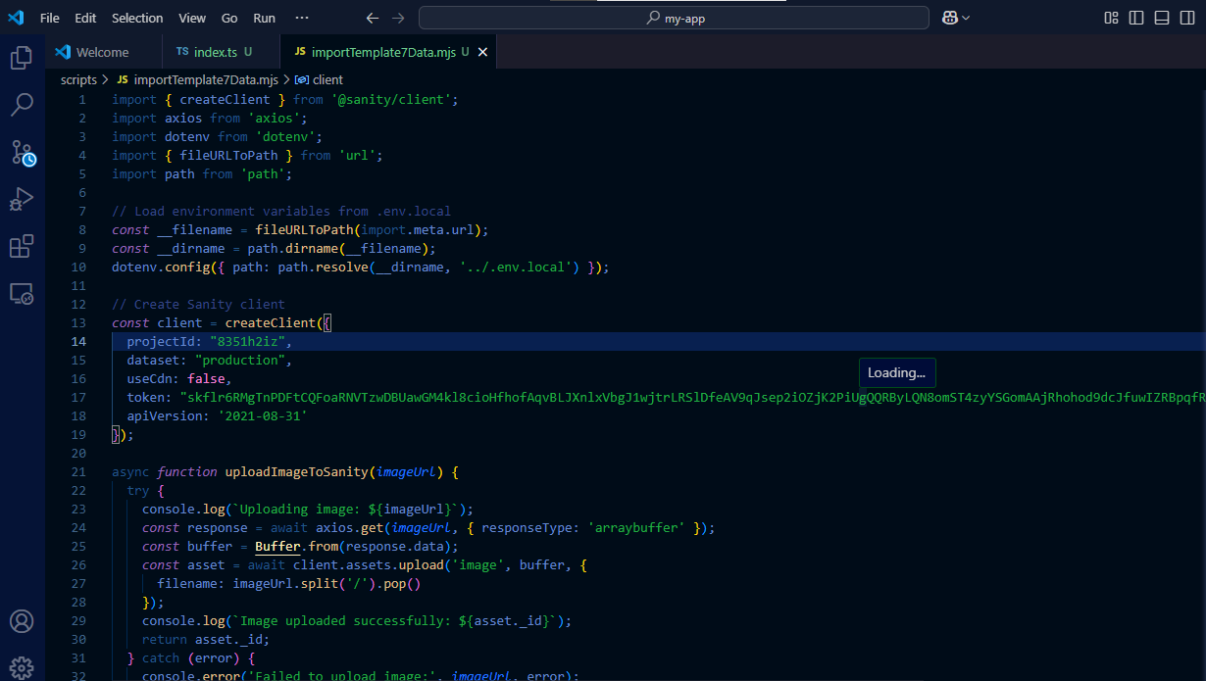

Slide 5
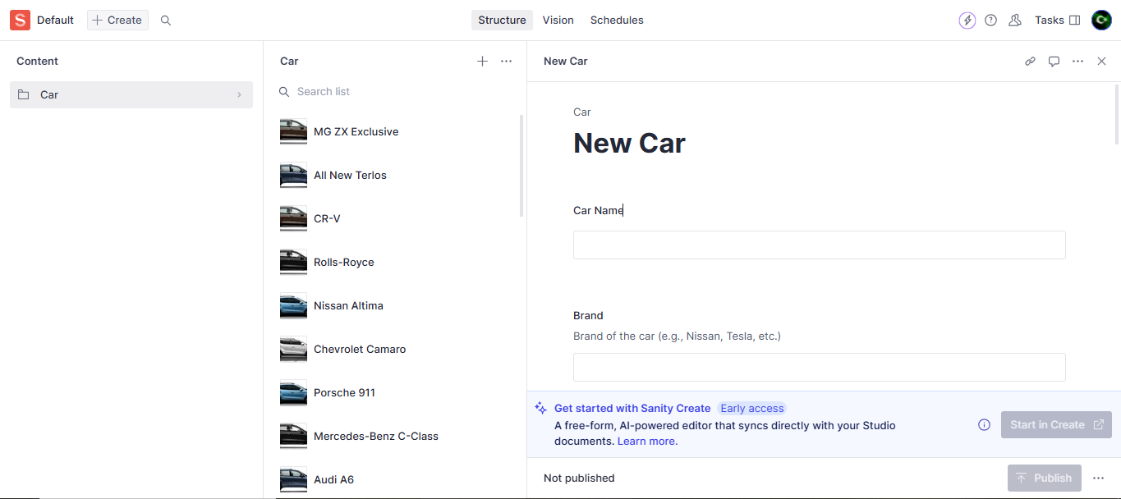
DATA SUCCESSFULLY MOUNTED

Slide 6
